Slide 1
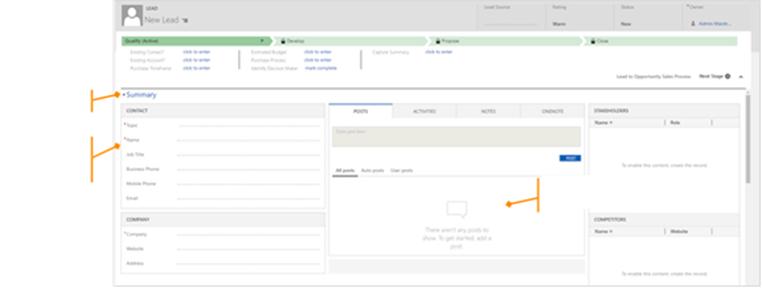
Color theme
Borders around containers and uniform spacing
Message and icon indicate empty areas

